Slide 2
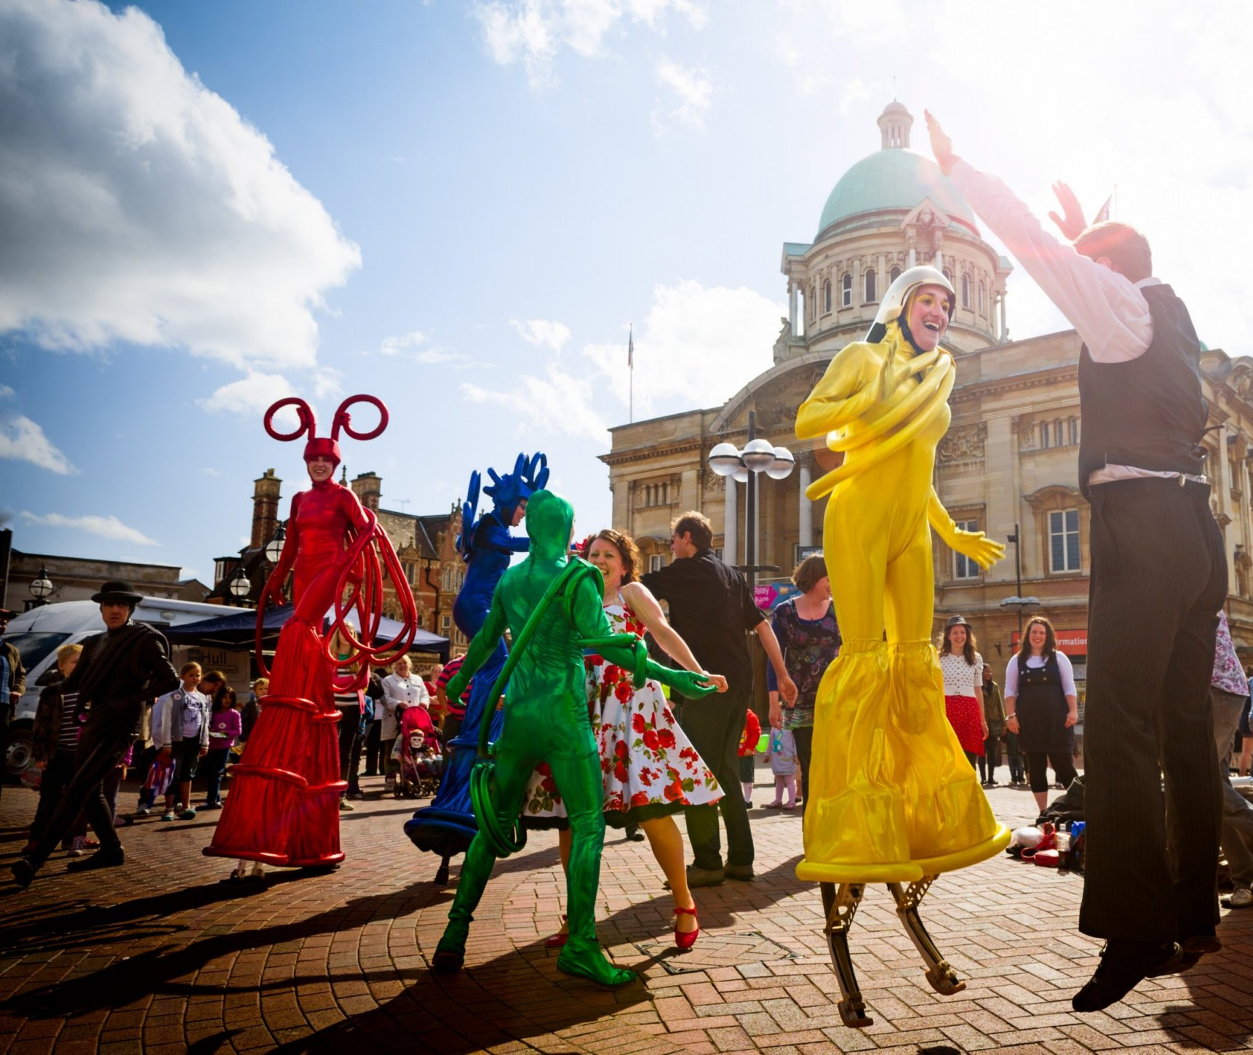
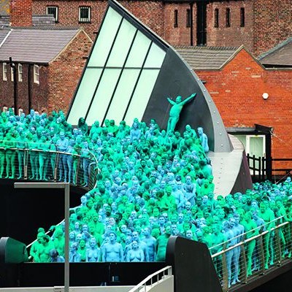
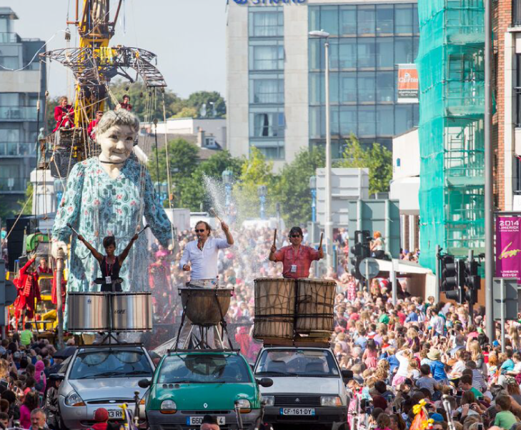
What is UK City of Culture?
UK City of Culture is a designation given to a city in the United Kingdom for a period of one year.
It’s aim is to give other cities the opportunity to experience similar success to Liverpool which was European Capital of Culture in 2008.
The competition is administered by the Department for Digital, Culture, Media and Sport and has a panel of independent judges.
The designation of UK City of Culture brings tangible economic, cultural and social benefits leading up to, during and beyond the year that the city holds the status.
In Liverpool during their reign as European Capital of Culture, the city generated £753.8M economic impact.
Hull saw visitor numbers double, sell-out crowds and nine out of ten of their residents engaged with the cultural events programme.

Slide 3
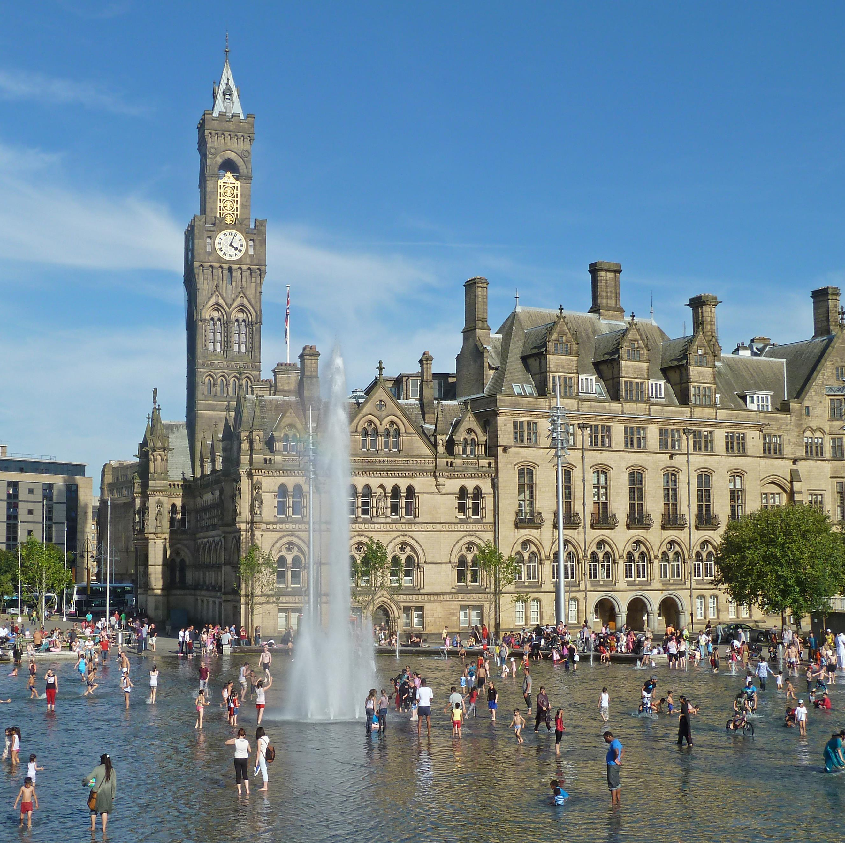
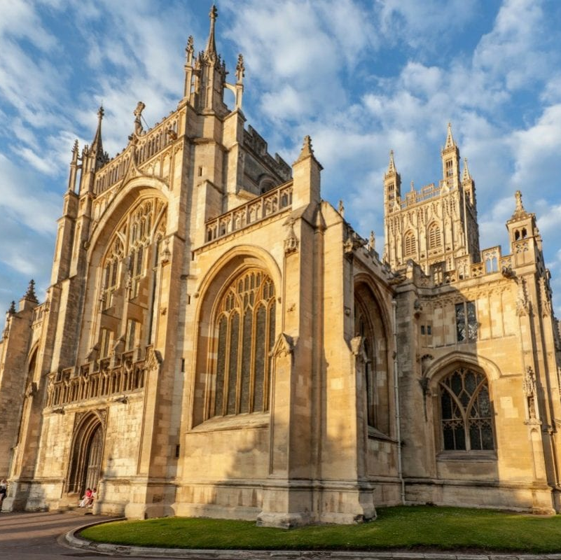
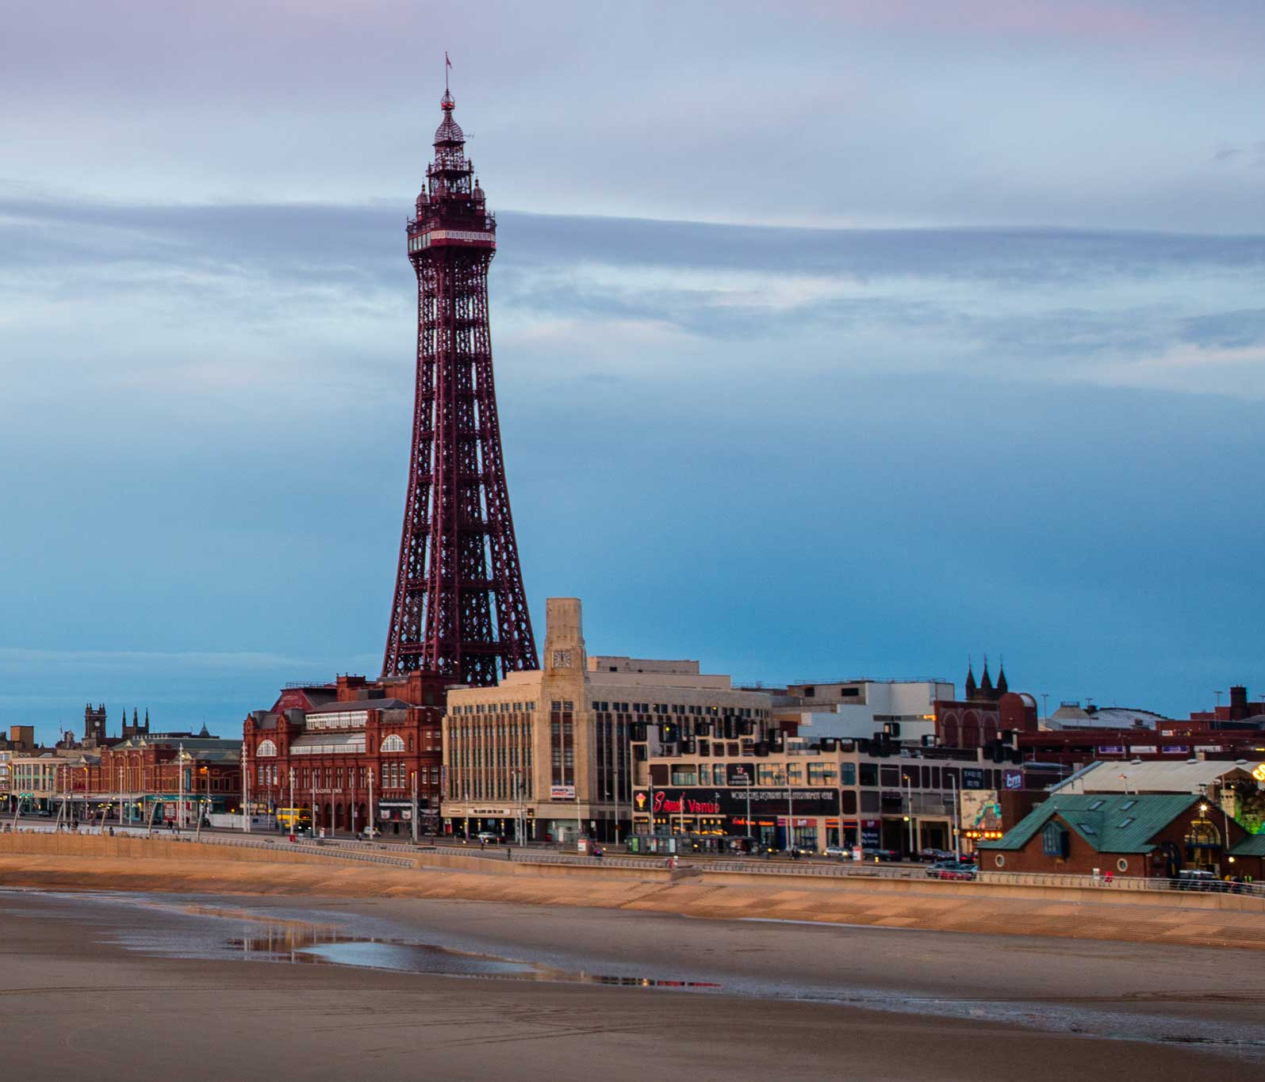
The Competition
Bradford
Medway
Lancashire
Gloucester

Slide 4
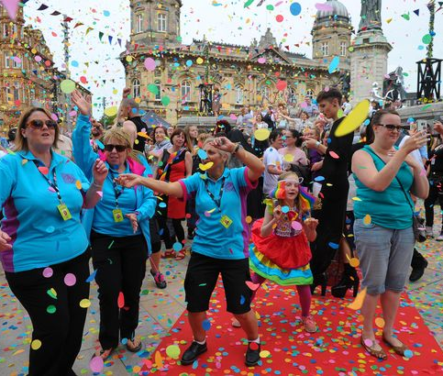
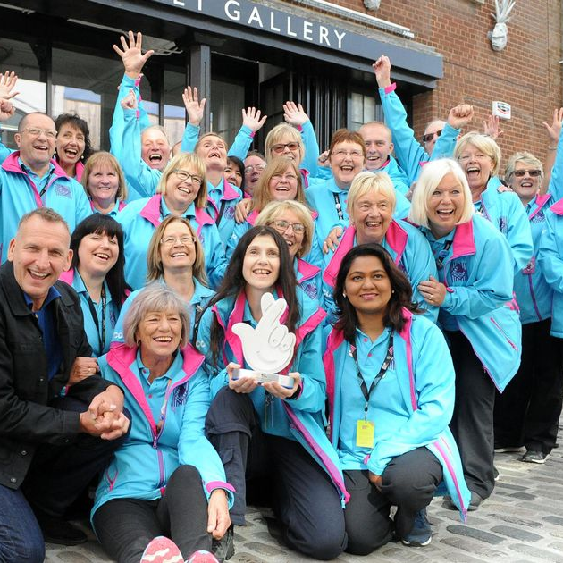
Winning UK City of Culture would…
Aid recovery in the context of COVID-19
Put Southampton and the wider region on the map, nationally and internationally
Generate economic impact and create a global competitive advantage which attracts investment
Raise aspirations and skills in the workforce
Lead to the establishment of new businesses and the creation of quality jobs to attract and retain talent
Create a sustainable commercial model, enabling the Southampton to deliver a meaningful legacy
Develop robust tourism, culture and heritage strategies, profiling Southampton as a competitive destination
Create civic pride, a strong sense of place, identity, wellbeing and community connections
Place cultural regeneration at the heart of the city

Slide 5
2021
Feb. 2021
Deadline for registration
April 2021
Deadline for submission of initial bid
May – June 2021
Response to clarification questions
First judges visit
Shortlisting for decision
July 2021
Further guidance on full and final bids
Sept. 2021
Deadline for submissions of full and final bids
Oct. 2021
Visit to short listed cities
Host visit from independent advisory panel member and DCMS project team
Nov. 2021
Dec. 2021
Further assessments of bids
Final decision on winning city
Announcement of winning city

Slide 6
Consultation
A robust and in-depth consultation process will enable us to:
Listen to our local community
Shape the UK City of Culture programme having identified the need of the local community
Develop engaging and transformational content for the city that will deliver significant PR profile, positioning Southampton as a World Class destination
Harness civic pride at the heart of all we do
Deliver a successful winning bid

